Slide 1
First-Order Methods

Slide 2
Gradient Descent
Search in direction of steepest descent

Slide 3
Gradient Descent
Applying gradient descent
and line search on Rosenbrock
function

Slide 4
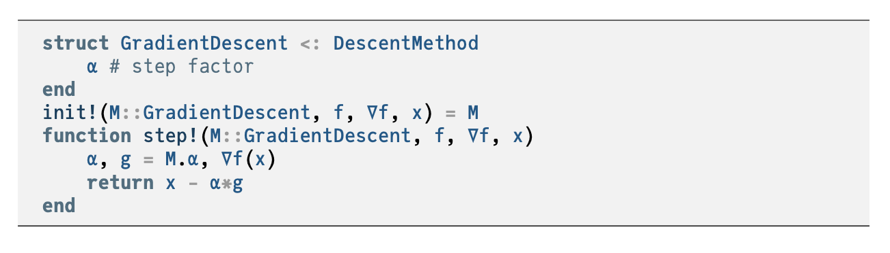

Slide 5
Momentum
Addresses common convergence issues
Some functions have regions with very small gradients

Slide 6
Momentum
Momentum update equations

Slide 7
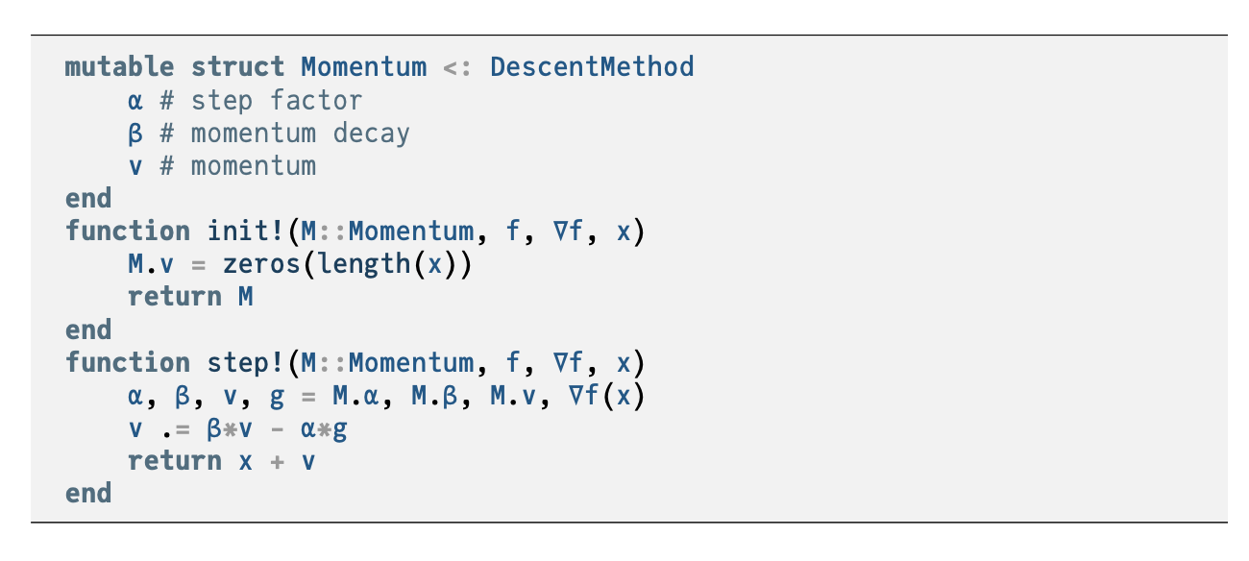

Slide 8
Momentum
Some functions cause gradient descent to get stuck
Momentum overcomes these issues by replicating the effect of physical momentum

Slide 9

Nesterov Momentum

Slide 10

Adagrad
Instead of using the same learning rate for all components of x, Adaptive Subgradient method (Adagrad) adapts the learning rate for each component of x.
For each component of x, the update equation is
where
$$ϵ≈1×{10}^{−8}$$

Slide 12
Second-Order Methods

Slide 13
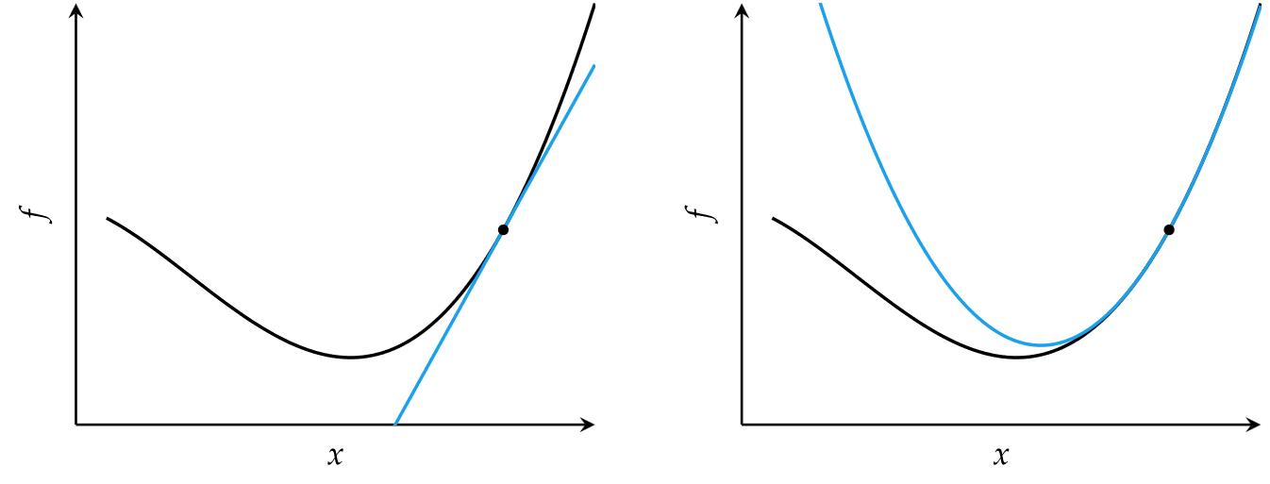

Slide 14

Second-Order Methods
Locally approximate function as quadratic
Comparison of first-order and second order approximations

Slide 15
Newton’s Method
Approximate a function using second-order Taylor series expansion
Univariate function

Slide 16
Newton’s Method
Multivariate function
Multivariate update rule
H is the Hessian matrix

Slide 17


Newton’s Method
Newton’s method for optimization is equivalent to finding the roots of the derivative function

Slide 18





Newton’s Method
Common causes of error in Newton’s method

Slide 19
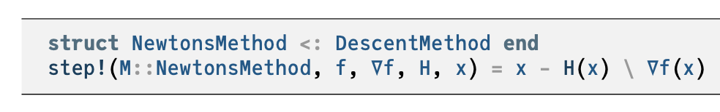

Slide 20
Secant Method
For univariate functions, if the second derivative is unknown, it can be approximated using the secant method
Update equation

Slide 21
Quasi-Newton Methods
For multivariate functions, the inverse Hessian may not be available or infeasible to compute, so can be approximated using a variety of Quasi-Newton methods, each appropriate in different circumstances
Davidon-Fletcher-Powell (DFP) method
Broyden-Fletcher-Goldfarb-Shanno (BFGS) method
Limited-memory BFGS (L-BFGS) method

